Slide 1

The word based encodings in TensorFlow
Notes:
1

Slide 2
Objectives
Understand sentiment in text
Learn how to make a computer understand the text
Understand word based encodings
The word based encodings in TensorFlow
2

Slide 3
Introduction
When we were dealing with images, it was relatively easy for us to feed them into a neural network, as the pixel values were already numbers.
What happens with text?
How can we do that with sentences and words?
→ Discuss and give your opinions
The word based encodings in TensorFlow
3
Notes:
3

Slide 4
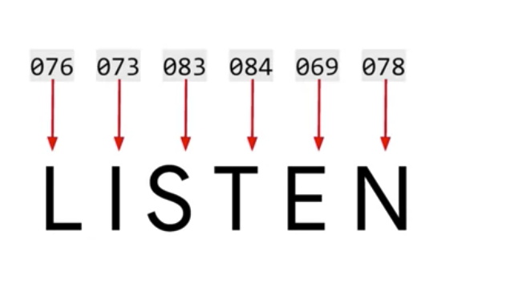
Word based encodings
Character encodings for each character in a set: ASCII values
Can ASCII help us understand the meaning of a word?
Example:
How the human and computer understand that word ?🡪 discuss and give your opinion
The word based encodings in TensorFlow
4
Notes:
4

Slide 5
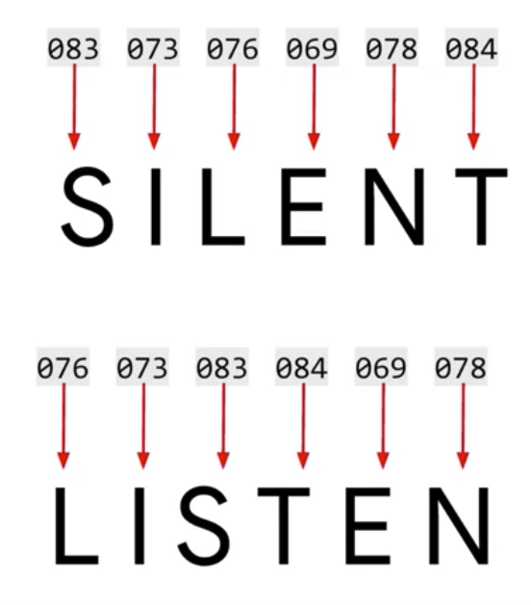
Word based encodings
Discuss a problem with two word has same a set of character:
How human and computer understand that words ? Discuss and give your opinion
The word based encodings in TensorFlow
5
Notes:
5

Slide 6

Word based encodings
How about if we consider words?
What if we could give words a value and have those values used in training a network?
How computer understand the mean of this sentence?
The word based encodings in TensorFlow
6
Notes:
6

Slide 7
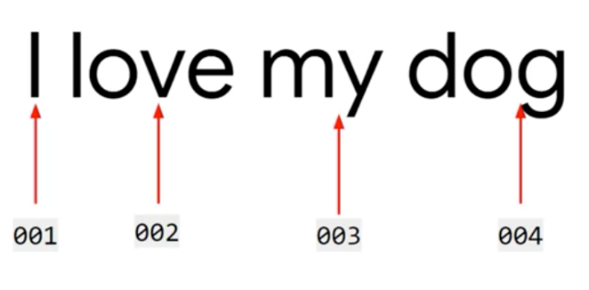
Word based encodings
Solution: giving a value to each word.
What that value is doesn't matter.
It's just that we have a value per word, and the value is the same for the same word every time.
'I' the value one, 'Love', 'my' and 'dog' the values 2, 3, and 4 respectively
I love my dog would be encoded as 1, 2, 3, 4.
The word based encodings in TensorFlow
7
Notes:
7

Slide 8
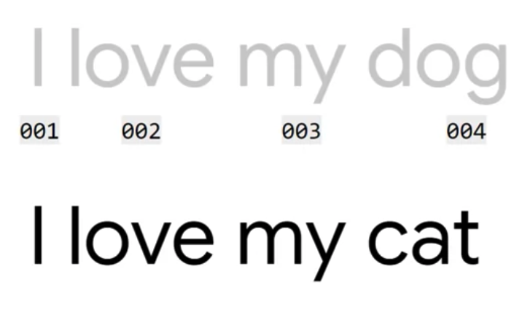
Word based encodings
What if I have the sentence, I love my cat?
Discuss and give your opinions
The word based encodings in TensorFlow
8
Notes:
8

Slide 9
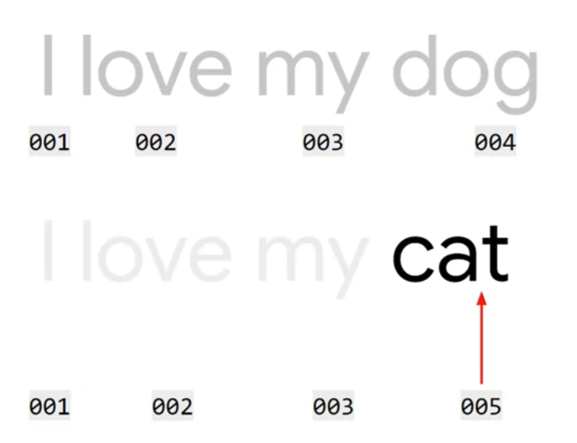
Word based encodings
Solution: we've already encoded the words 'I love my' as 1, 2, 3. So we can reuse those, and we can create a new token for cat- number 5.
The word based encodings in TensorFlow
9
Notes:
9

Slide 10
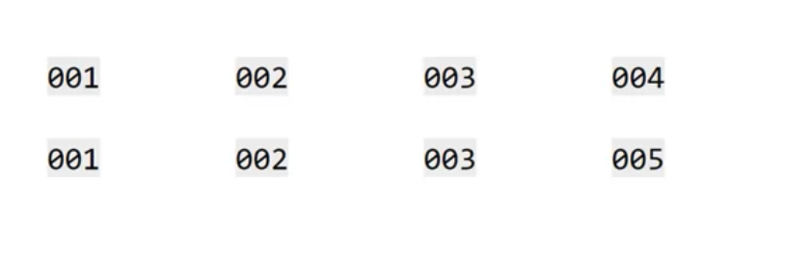
Word based encodings
Look at the two sets of encodings, we can begin to see some similarity between the sentences
Now student give your opinion: how computer understand the sentence?
The word based encodings in TensorFlow
10
Notes:
10

Slide 11
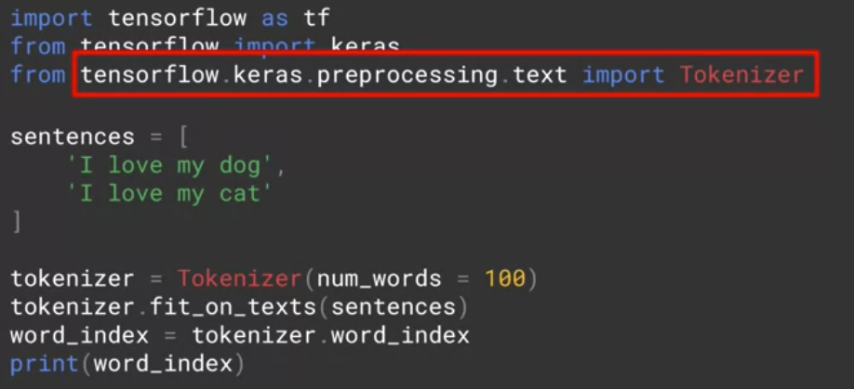
Sentence understand in tensorFlow
Tensorflow and keras give us a number of ways to encode words: the tokenizer
The tokenizer: generating the dictionary of word encodings and creating vectors out of the sentences
The word based encodings in TensorFlow
11
Notes:
11

Slide 12
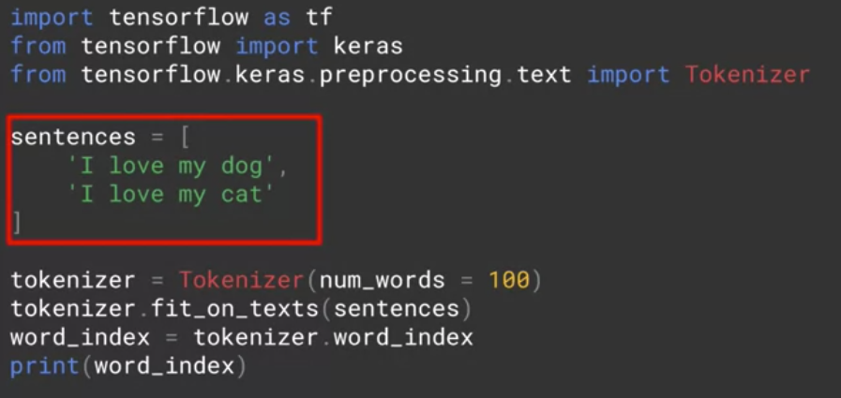
Sentence understand in tensorFlow
Put the sentences into an array.
The word based encodings in TensorFlow
12
Notes:
12

Slide 13
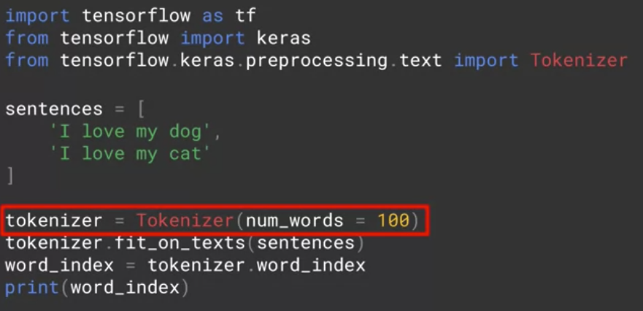
Sentence understand in tensorFlow
Create an instance of the tokenizer. A passive parameter num wards to it.
Discuss: What happens if the num_words value is small or large? - What effect does it have on the model?
The word based encodings in TensorFlow
13
Notes:
13

Slide 14
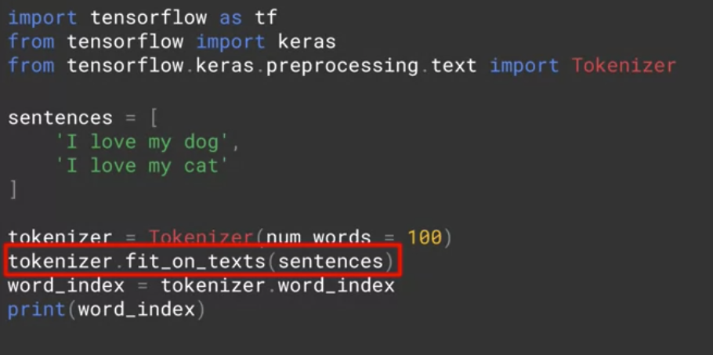
Sentence understand in tensorFlow
Fit on texts method of the tokenizer then takes in the data and encodes it
The word based encodings in TensorFlow
14
Notes:
14

Slide 15
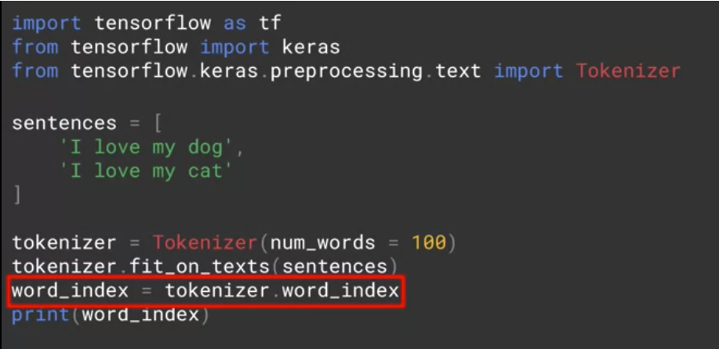
Sentence understand in tensorFlow
The tokenizer provides a word index property which returns a dictionary containing key value pairs, where the key is the word, and the value is the token for that word
The word based encodings in TensorFlow
15
Notes:
15

Slide 16
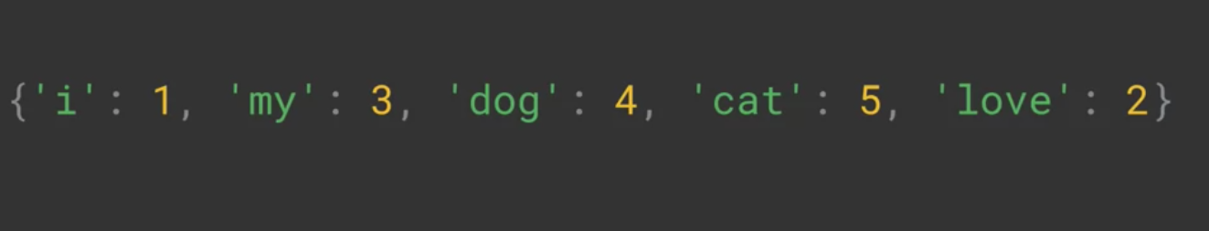
Sentence understand in tensorFlow
The results
The word based encodings in TensorFlow
16
Notes:
16

Slide 17
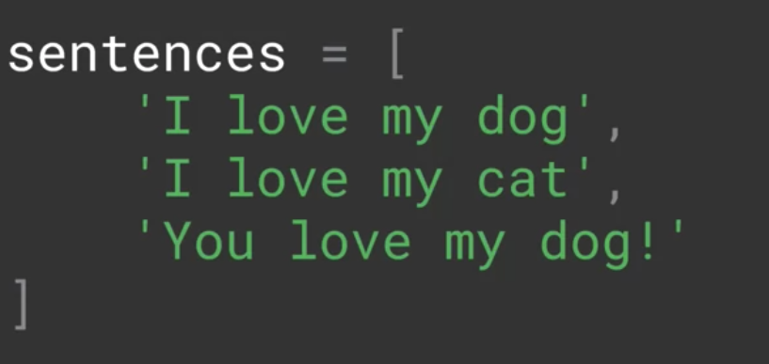
Sentence understand in tensorFlow
Student guess the code of that sentence below
The word based encodings in TensorFlow
17
Notes:
17

Slide 18
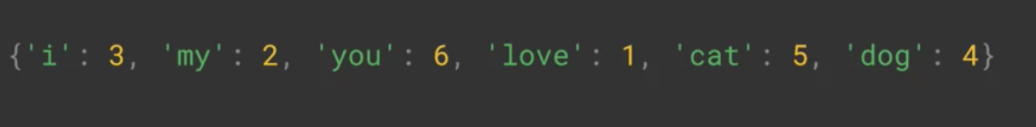
Sentence understand in tensorFlow
The result of sentence coding
The word based encodings in TensorFlow
18
Notes:
18

Slide 19
Summary
Understand sentiment in text
Learn how to computer that understand text
Understand word based encodings
The word based encodings in TensorFlow
19

Slide 20
Q & A
The word based encodings in TensorFlow
20

